Slide 1
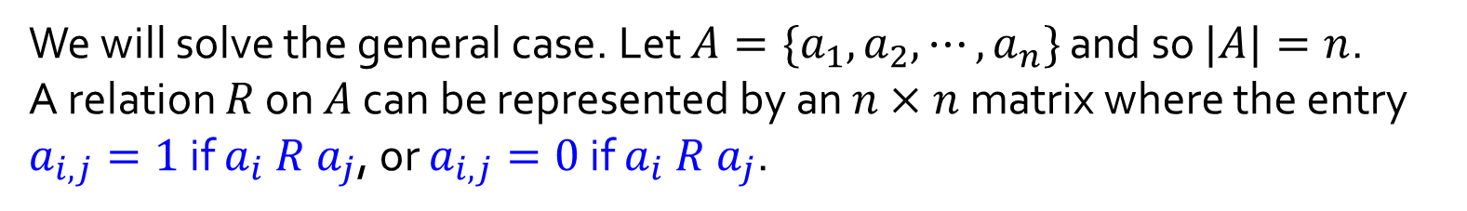
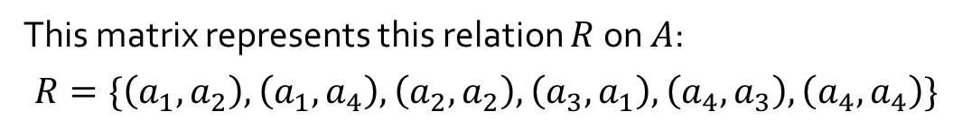
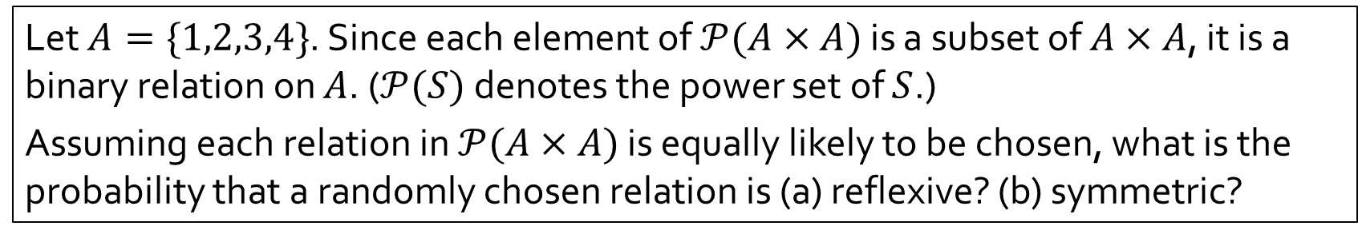


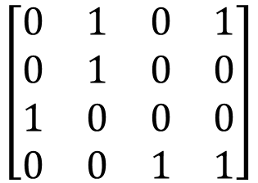
Q6.
Let $A=\{1,2,3,4\}$. Since each element of $𝒫(A×A)$ is a subset of $A×A$, it is a binary relation on $A$. ($𝒫(S)$ denotes the power set of $S$.)
Assuming each relation in $𝒫(A×A)$ is equally likely to be chosen, what is the probability that a randomly chosen relation is (a) reflexive? (b) symmetric?
We will solve the general case. Let $A=\{a_{1},a_{2},⋯,a_{n}\}$ and so $|A|=n$.
A relation $R$ on $A$ can be represented by an $n×n$ matrix where the entry $a_{i,j}=1$ if $a_{i} R a_{j}$, or $a_{i,j}=0$ if $a_{i} R a_{j}$.
Example:
$$a_{1}{ a}_{2} a_{3} a_{4}$$
$$a_{1}$$
$$a_{2}$$
$$a_{3}$$
$$a_{4}$$
$$\left[\begin{matrix}0 & 1 & 0 & 1 \\ 0 & 1 & 0 & 0 \\ 1 & 0 & 0 & 0 \\ 0 & 0 & 1 & 1\end{matrix}\right]$$
This matrix represents this relation $R$ on $A$:
$$R=\{\left(a_{1},a_{2}\right),\left(a_{1},a_{4}\right),\left(a_{2},a_{2}\right),\left(a_{3},a_{1}\right),\left(a_{4},a_{3}\right),\left(a_{4},a_{4}\right)\}$$

Slide 2
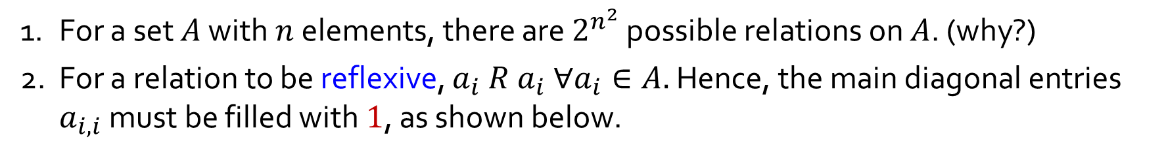
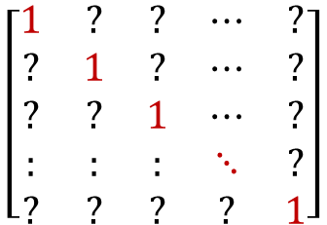
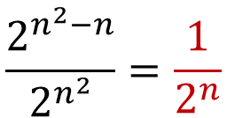
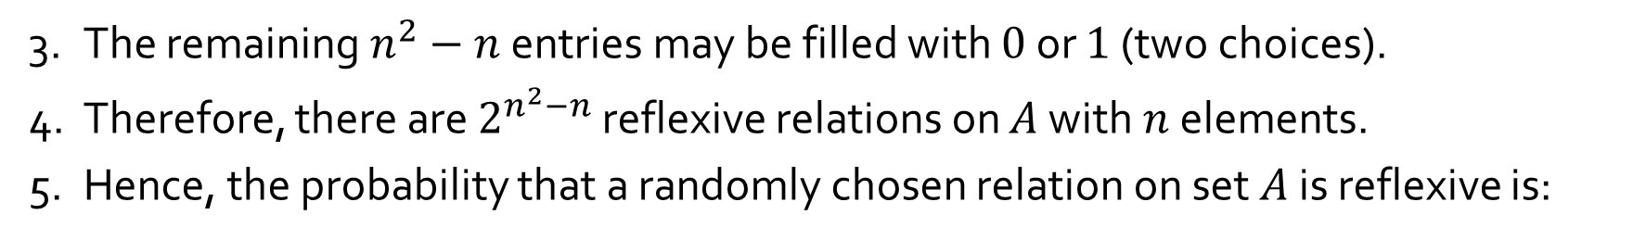
Q6.
(a) Reflexive relations
1. For a set $A$ with $n$ elements, there are $2^{n^{2}}$ possible relations on $A$. (why?)
2. For a relation to be reflexive, $a_{i} R a_{i} ∀a_{i}∈A.$ Hence, the main diagonal entries $a_{i,i}$ must be filled with $1$, as shown below.
$$\left[\begin{matrix}1 & ? & ? & ⋯ & ? \\ ? & 1 & ? & ⋯ & ? \\ ? & ? & 1 & ⋯ & ? \\ : & : & : & ⋱ & ? \\ ? & ? & ? & ? & 1\end{matrix}\right]$$
3. The remaining $n^{2}−n$ entries may be filled with $0$ or $1$ (two choices).
4. Therefore, there are $2^{n^{2}−n}$ reflexive relations on $A$ with $n$ elements.
5. Hence, the probability that a randomly chosen relation on set $A$ is reflexive is:
$$\frac{2^{n^{2}−n}}{2^{n^{2}}}=\frac{1}{2^{n}}$$
In particular, when $n=4$, the probability is $\frac{1}{2^{4}}$ or $\frac{1}{16}.$

Slide 3
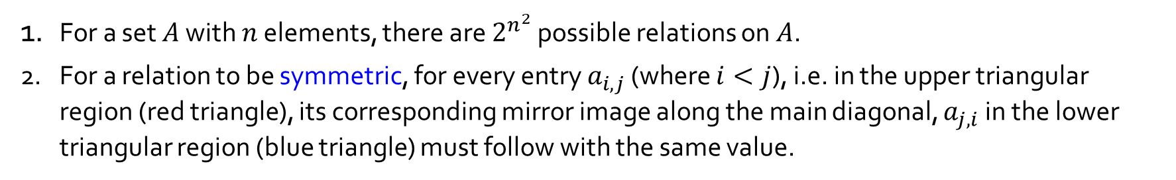


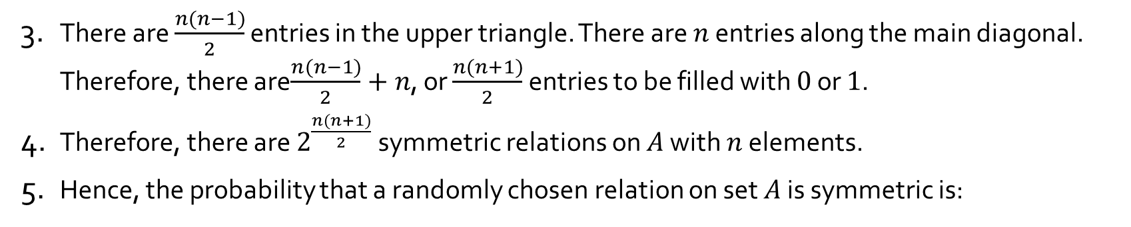
Q6.
(b) Symmetric relations
1. For a set $A$ with $n$ elements, there are $2^{n^{2}}$ possible relations on $A$.
2. For a relation to be symmetric, for every entry $a_{i,j}$ (where $i<j$), i.e. in the upper triangular region (red triangle), its corresponding mirror image along the main diagonal, $a_{j,i}$ in the lower triangular region (blue triangle) must follow with the same value.
$$\left[\begin{matrix}? & ? & ? & ⋯ & ? \\ ? & ? & ? & ⋯ & ? \\ ? & ? & ? & ⋯ & ? \\ : & : & : & ⋱ & ? \\ ? & ? & ? & ? & ?\end{matrix}\right]$$
3. There are $\frac{n(n−1)}{2}$ entries in the upper triangle. There are $n$ entries along the main diagonal. Therefore, there are$\frac{n(n−1)}{2}+n$, or $\frac{n(n+1)}{2}$ entries to be filled with $0$ or $1$.
4. Therefore, there are $2^{\frac{n(n+1)}{2}}$ symmetric relations on $A$ with $n$ elements.
5. Hence, the probability that a randomly chosen relation on set $A$ is symmetric is:
$$\frac{2^{\frac{n(n+1)}{2}}}{2^{n^{2}}}=\frac{1}{2^{\frac{n^{2}−n}{2}}}$$
In particular, when $n=4$, the probability is $\frac{1}{2^{6}}$ or $\frac{1}{64}.$

